Slide 1


Central University of Technology
WebApp, Invoicing, Accommodation and Car Vouchers

Slide 2
Training Overview
Day 1: Introduction & Training
1. Introduction
2. Theory
3. Practical Sessions
Creating:
  Consultants
  Debtor/Corporate Client Accounts
  Leisure Client Accounts
  Supplier Accounts (Land)
Issuing Vouchers:
  Service Vouchers
  Car Hire Vouchers
Invoicing Practice:
  Accommodation
  Car Hire
  Air Tickets
  Service Fees

Slide 3
Training Overview
Day 2: Recap & Assessment
Recap:
      Review of key concepts and processes covered on Day 1.
Exam:
  60% pass rate

Slide 4
Methods of payments used by clients
Billback (Cash)
Client pays agency (via EFT or in cash)
Agency takes commission
Agency pays the difference to the supplier
Direct Settlement (Credit Cards)
Client pays supplier (via credit card)
Agency claims commission from supllier
Supplier pays commission to agency

Slide 5

Methods of payments used to pay suppliers
BSP (Billing and Settlement Plan)
BSP is the central organisation that facilitates payments between the agencies and airlines.
Most airlines are paid via BSP
COD (Cash On Delivery)
Payments made as soon as services are completed or shortly thereafter.
The agency DOES NOT have an account with the supplier.
Month-end
Month-End, as the name suggests, is when the agency pays for all the travel at the end of the month. This happens when the agency has an account with the supplier.

Slide 6


Types of clients
Debtors/Corporate Clients
Debtors are corporate clients, who have accounts with the agency.
Examples include municipalities, departments (such as education) or any company.
Note: Debtors have a D prefix e.g D00002
Leisure Clients
Leisures are walk-in clients, the person off the street, who is travelling for pleasure.
Examples include people like me and you.
Note: Leisures have an L prefix e.g L00002

Slide 7
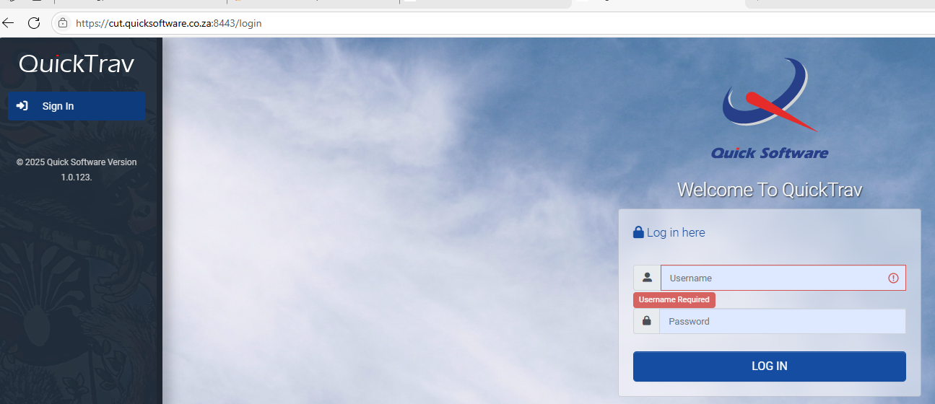
How to access QT WebApp:
URL: https://clienthost03.quicksoftware.co.za:8443/
Username: WILL BE ON STICKY NOTE @ YOUR DESK
Pwd: CutWeb@1
You will be directed to the following web page:
Add in your username and password.
Select “LOG IN”

Slide 8
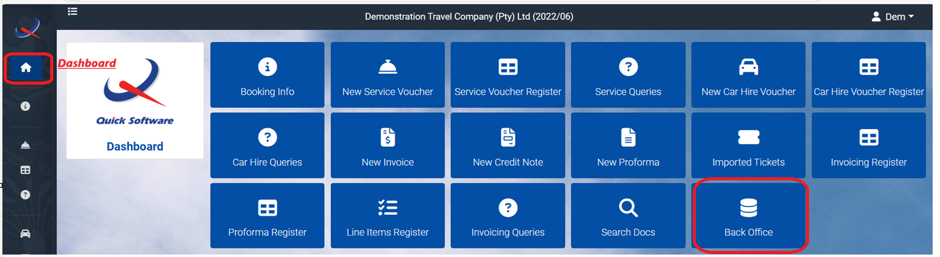
STEP 1
NB – Set Yourself Up As A Consultant Before Using QuickTrav™
To issue documents in QuickTrav™, users need to first set themselves up as a consultant.
Locate the “Dashboard” and then select “Back Office”

Slide 9
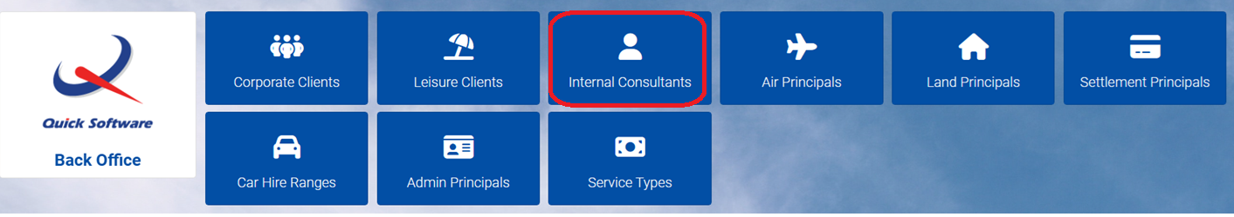
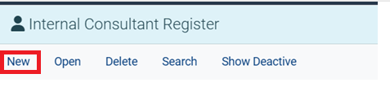
Select “Internal Consultants”.
Select “New”

Slide 10
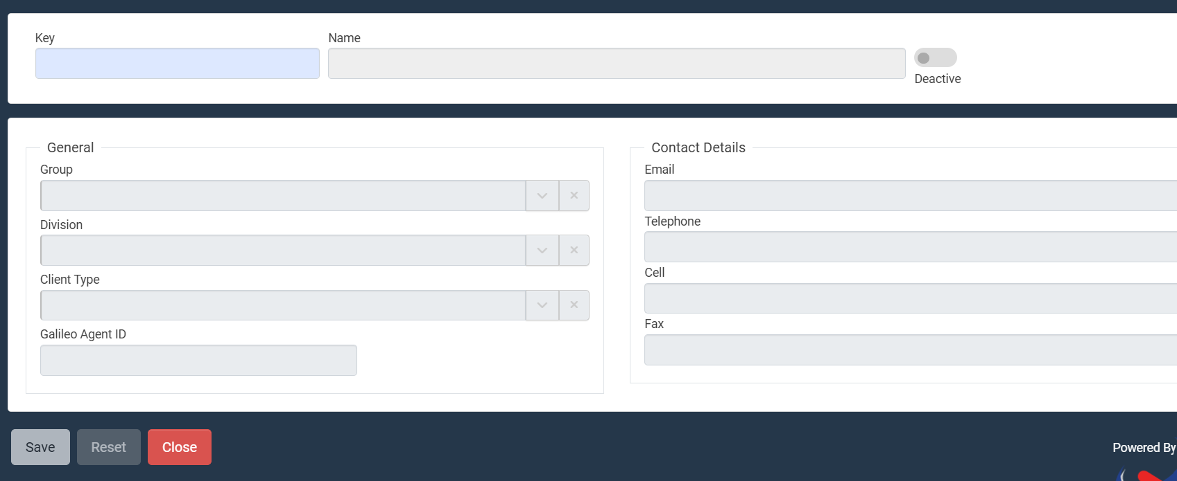
**Please note - All blue fields in QT are compulsory fields. You will not be able to save the record if any of these fields are left blank. **
The “Key” is the only compulsory field for now.
Key - Input the initials of your name and surname.
Once you’ve specified the key, please press “tab” on your keyboard to go to the next field and enter your “Name”.
Once all blue fields are completed select “Save”.
Your consultant details should now appear in the register.
***Reminder: This is only done once!!***

Slide 11
NB - Always ensure that your name reflects when setting up clients, suppliers or capturing documents.
Creating New Clients and Principals:
All Setups are done in the “Back Office”.
You will only need to create the following types of records:
New Debtor/Corporate Client
Has an account with the agency and they owe you money for services provided (Use D prefix).
For example: Municipalities, Department of Education, Coca Cola and Laerskool Monument.
New Leisure Client
Walk in client (Use L prefix).
For example: Mr K Wilkens, Mrs S Jones, Ms T Ndluvo and Dr M Mbatha.
Land Principal/Supplier
Any Hotel, B&B, Guesthouse, Car Hire etc.
For example: Hilton Hotel, City Lodge Hotel, AVIS care hire, Keri’s B&B and Tertia’s Guest House.
***Reminder: All setups are done in the “Back Office”!!***

Slide 12
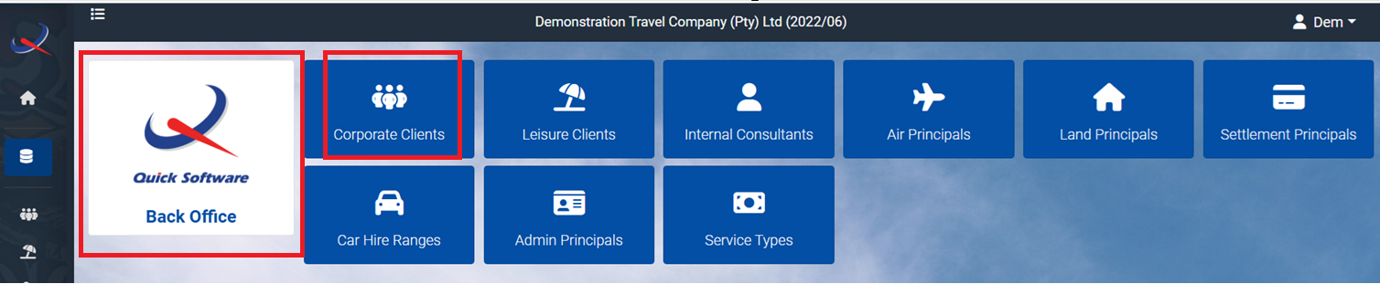

How to set up new corporate/debtor clients
To create new Corporate/Debtor clients, select “Corporate Clients”:
Then, select “New”.

Slide 13
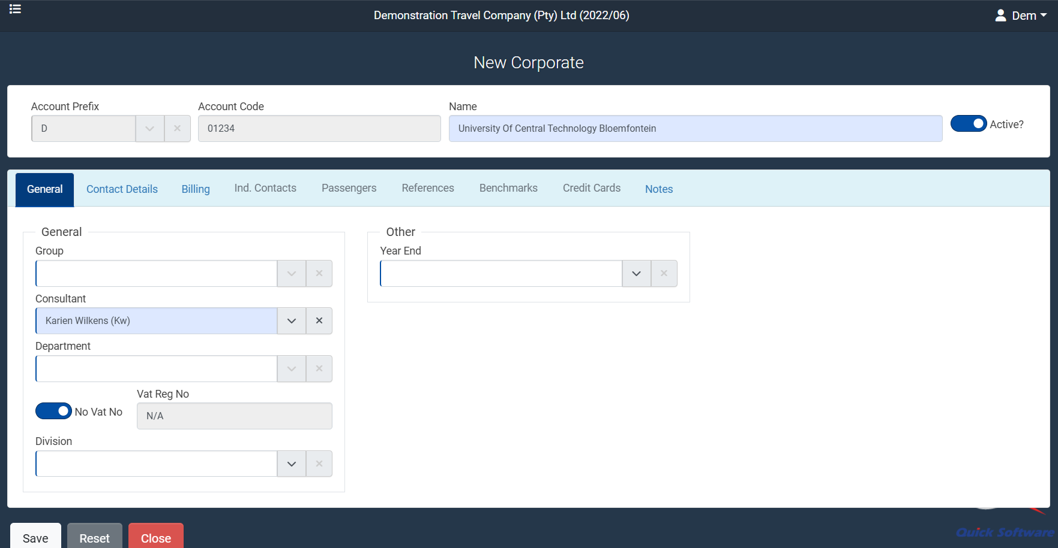
As mentioned previously, all blue fields are compulsory and need to be completed.
Account Prefix - Remember, the prefix for Corporate/Debtor clients is D.
Account Code - This needs to be unique. Start with 001 and continue numerically.
Name - This is the business name.
Consultant - You need to select your name is from the dropdown menu.
Vat Reg No - Activate the switch for “No Vat No.”, unless the VAT No. is specified.
Once the above steps are completed, select “Save”.

Slide 14
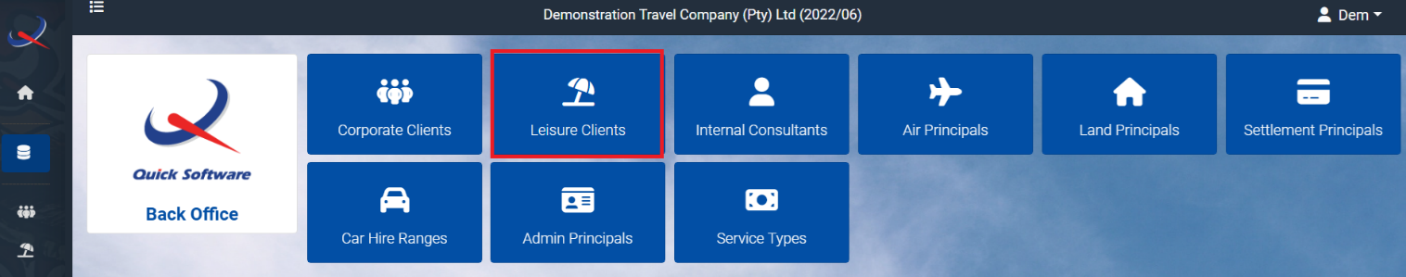
How to set up yourself as a leisure
The setup is very similar to the corporate/debtor set up which needs to be done in the back office.
Once you have selected “Leisure Clients”, ask yourself the following questions and fill this information under the ‘General’ and ‘Contact Details’ tabs:
Who am I? Fill in your name.
What is my contact number? Fill in your cell number.
Where do I stay? Fill in your address details that need to appear on the tax invoice.

Slide 15
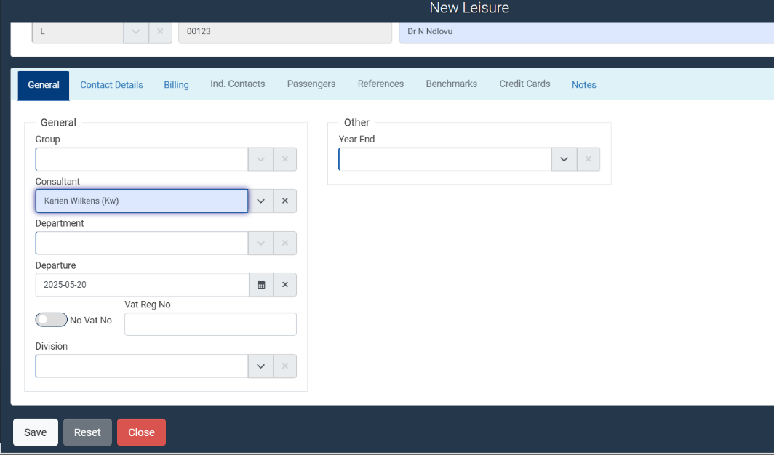
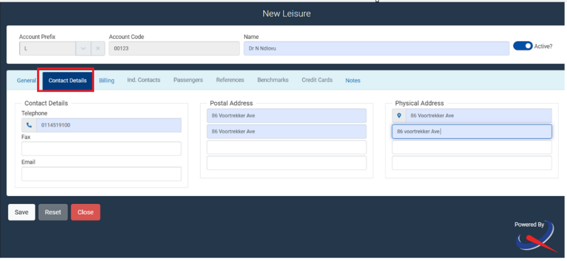

Slide 16
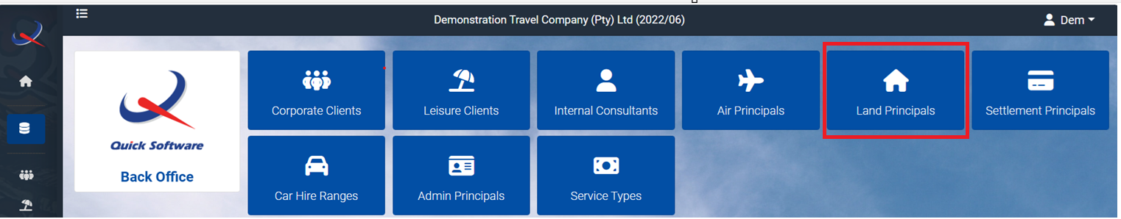
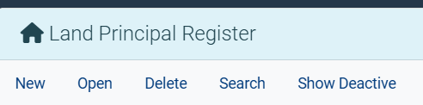
How to set up new land principals/suppliers
Select “New”.

Slide 17
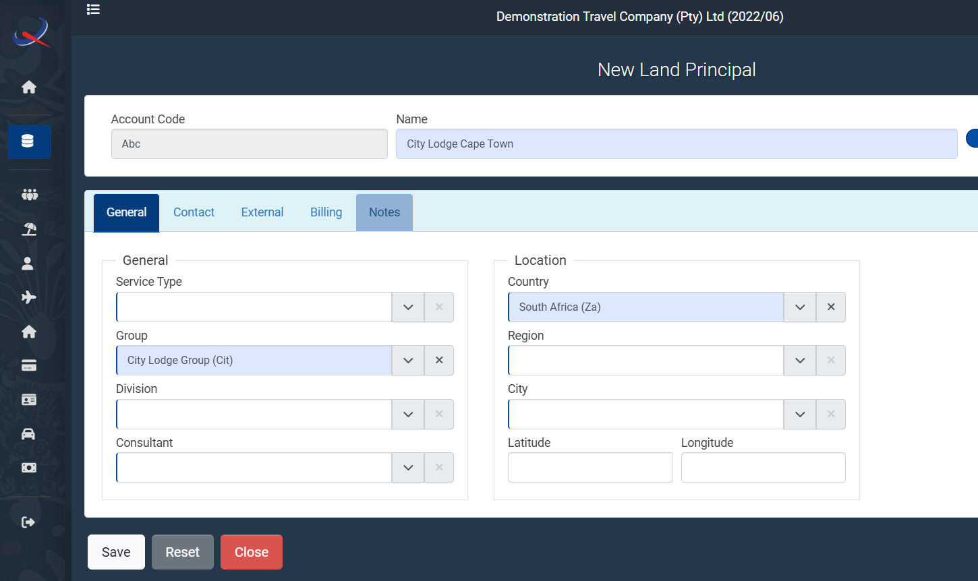
Complete all the required fields below
Account Code - Unique 3 letter code
Account Name - Hotel, Lodge Name
Group - Can be selected from the dropdown

Slide 18
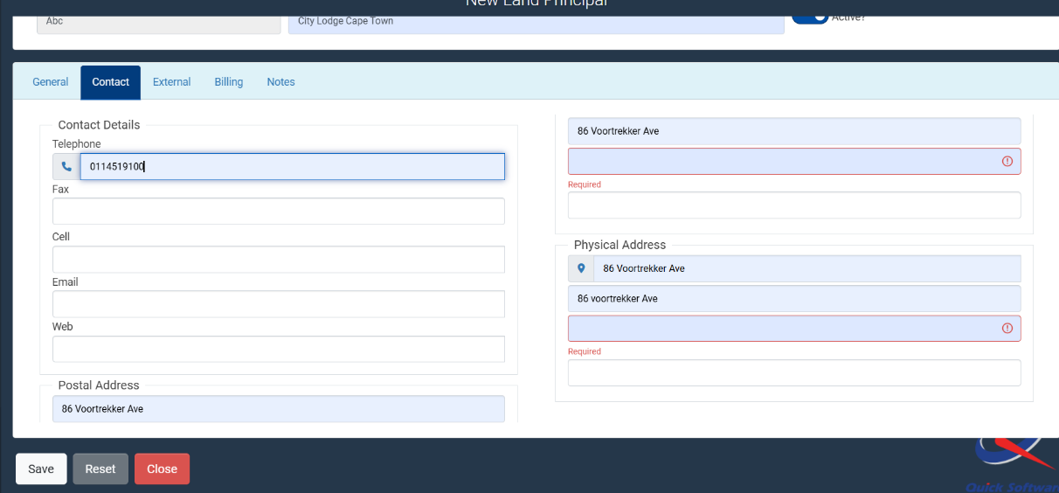
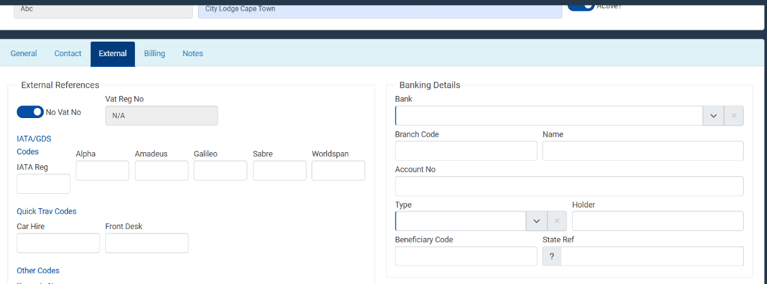
Move to the “Contact” tab and complete required fields:
Move to the “External” tab and specify the VAT number or activate the “No Vat No.” switch.

Slide 19
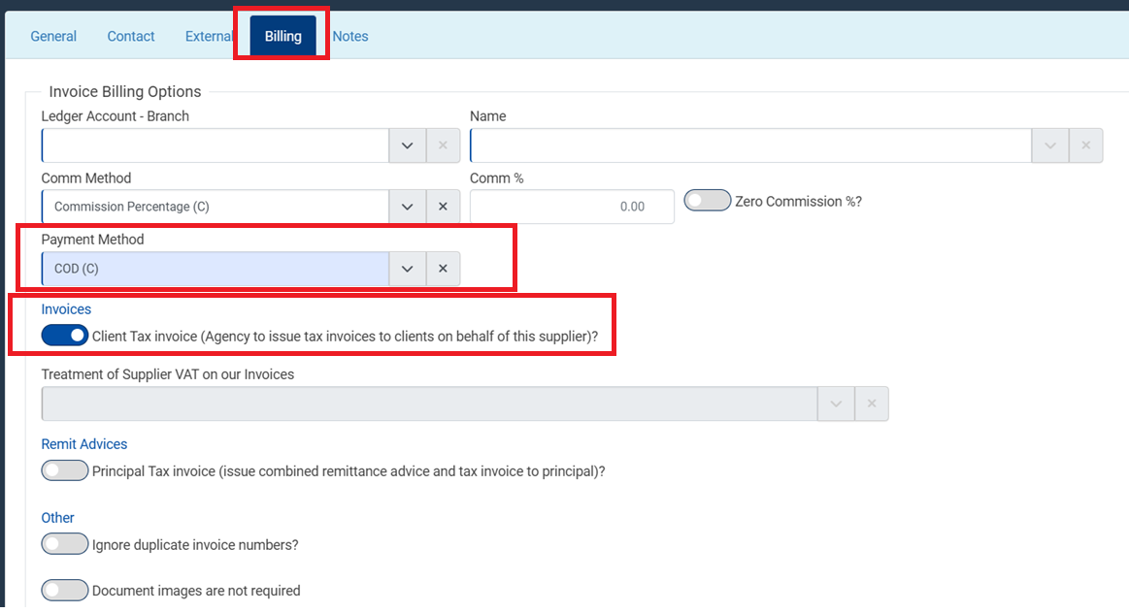
Lastly, before saving, select the “Billing” tab and specify the payment method as COD. Then activate the “Client Tax Invoice” switch to ensure the VAT prints on the invoice.

Slide 20
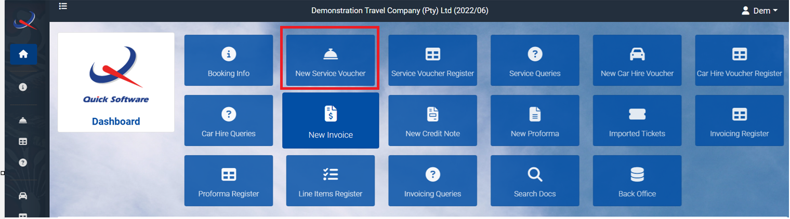
How to issue accommodation vouchers
On the “Dashboard” select “New Service Voucher”

Slide 21
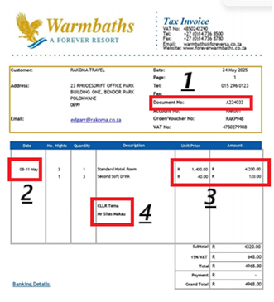
Complete all compulsory fields from the example:
Supplier Ref
Check in and Check out Period
Rate per night and total for duration
Passenger name

Slide 22
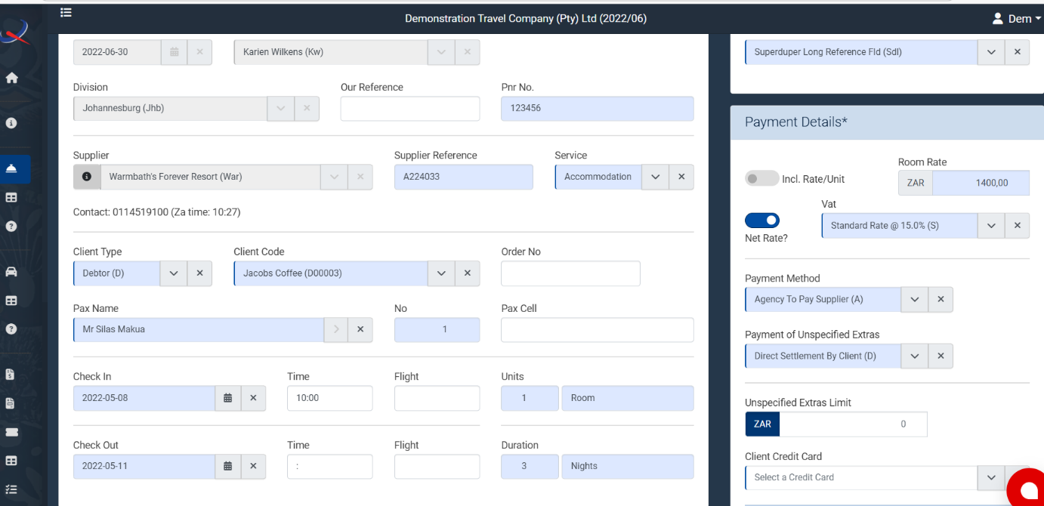

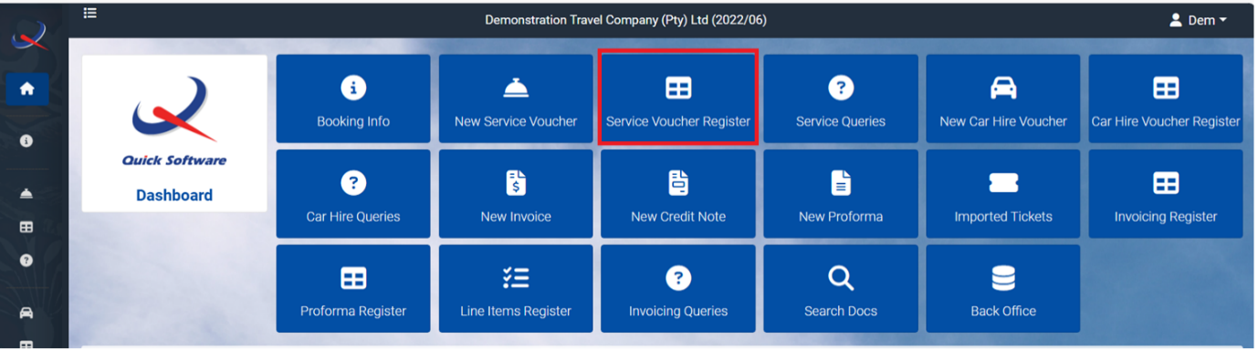
Once all compulsory fields are completed – select “Save as Hold”.
You can then view the “Service Voucher Register” and ensure that the voucher has been saved:

Slide 23

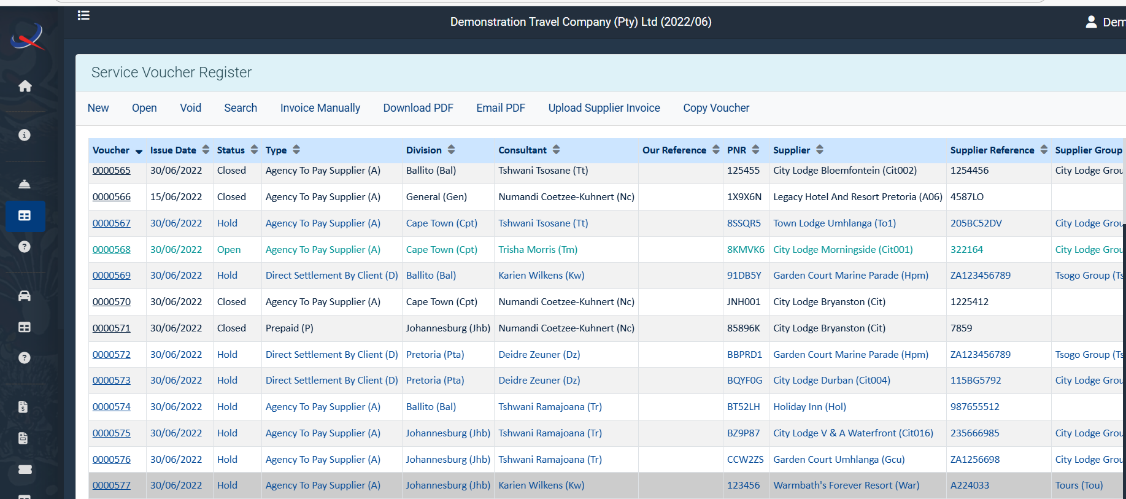
You can then view the “Service Voucher Register” and ensure that the voucher has been saved:

Slide 24
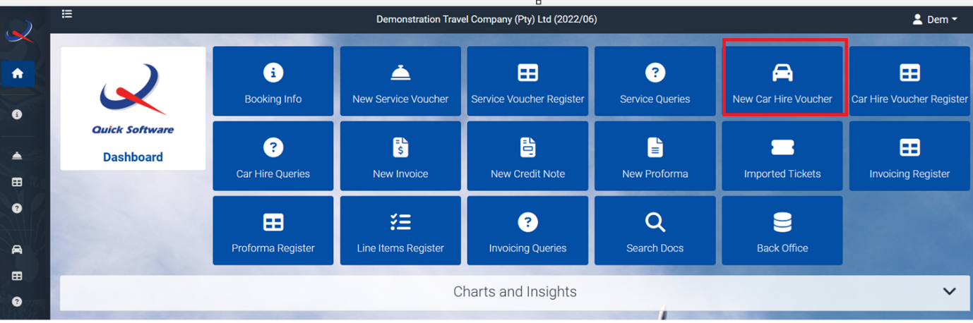
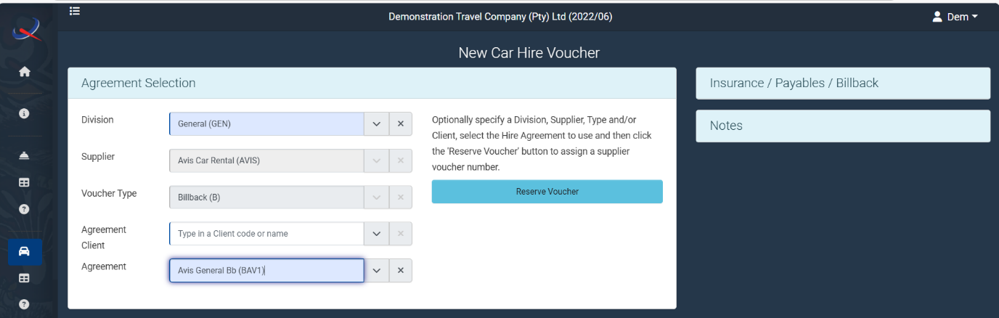
How to issue a car voucher:
On the “Dashboard” select “New Car Hire Voucher”
Car Vouchers are different from Accommodation Vouchers, you first have to select the Agreement:

Slide 25

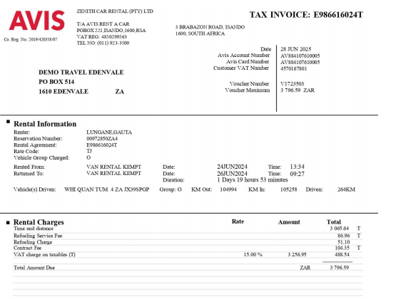
Once you have the correct agreement you can “Reserve Voucher”
By reserving the voucher you can now complete all compulsory fields from the example:

Slide 26
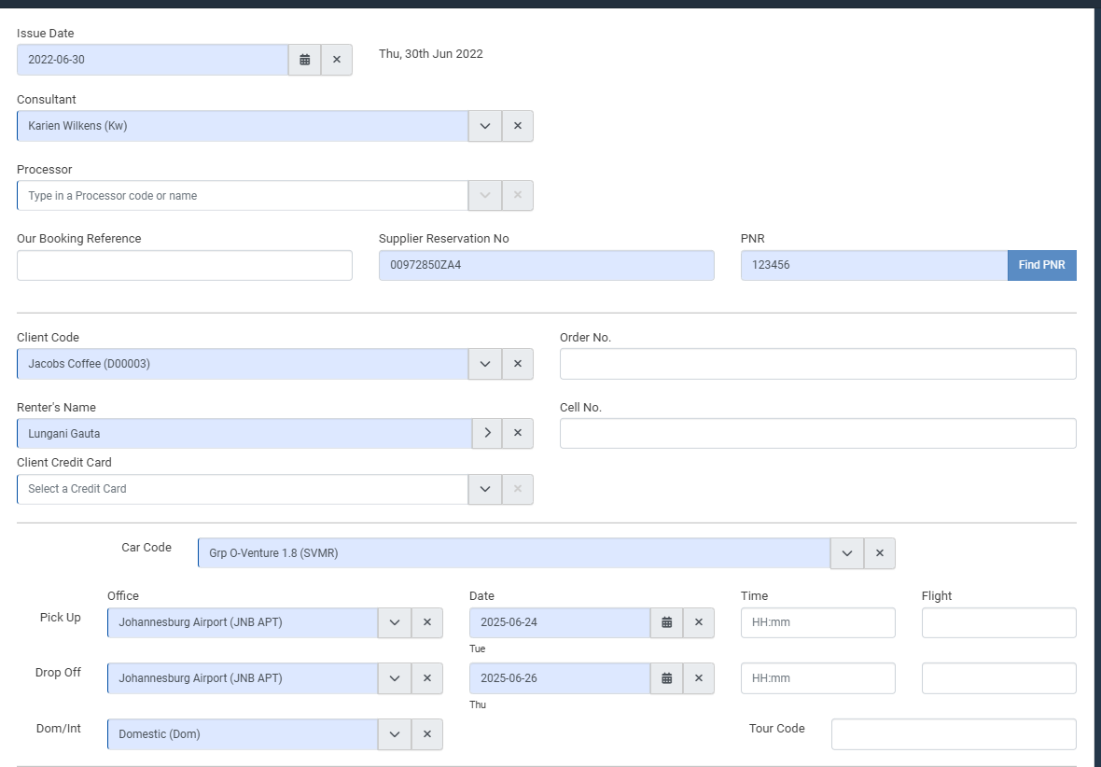

Once all compulsory fields are completed:
“Save as Hold”

Slide 27
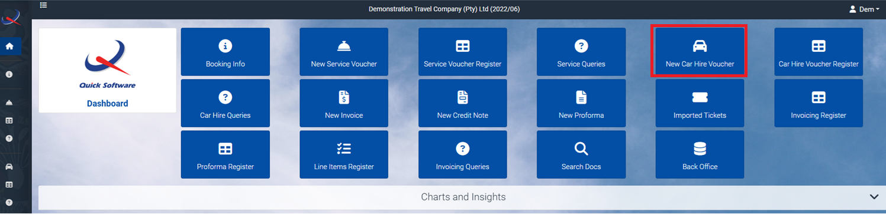
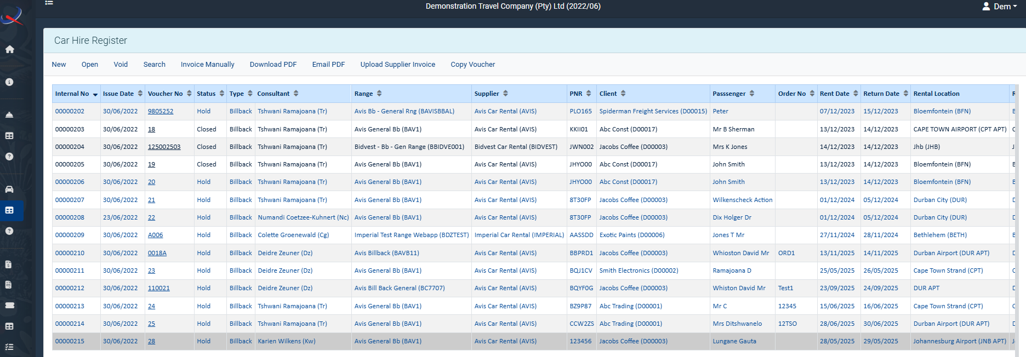
You can check the Car Voucher Register to ensure that the voucher was saved successfully:

Slide 28
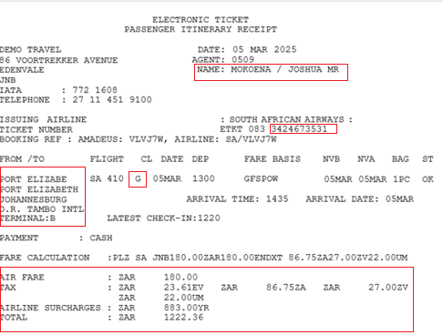
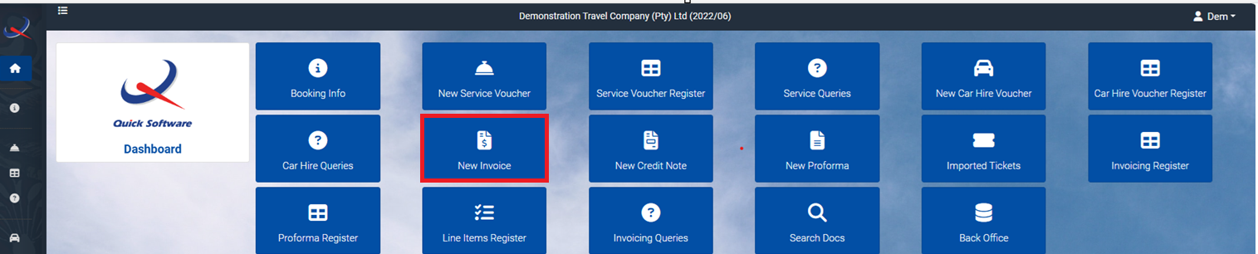
Invoicing Air Tickets:
Passenger name, ticket number, routing details, classes, fare and airport taxes will be found in the ticket.
Select the “New Invoice” from the “Dashboard”

Slide 29
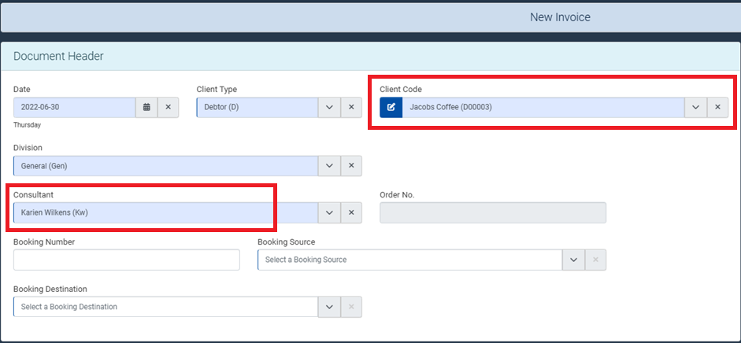
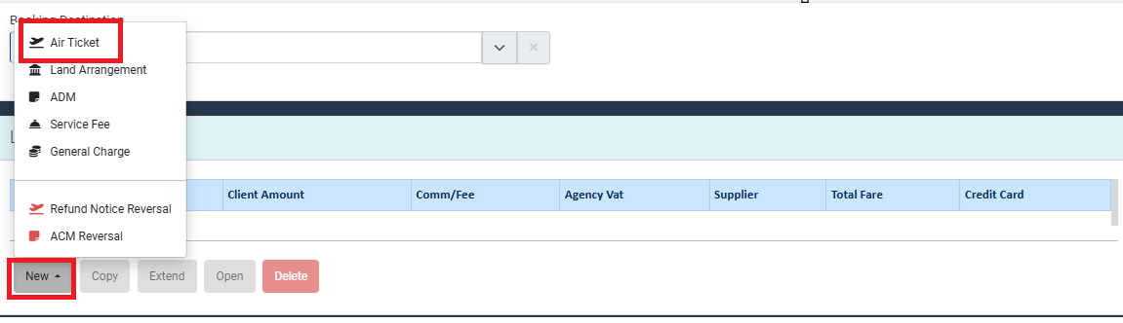
Complete the document header info – “Client” and “Consultant”
Once above details completed – select “New” and select “Air Ticket”

Slide 30
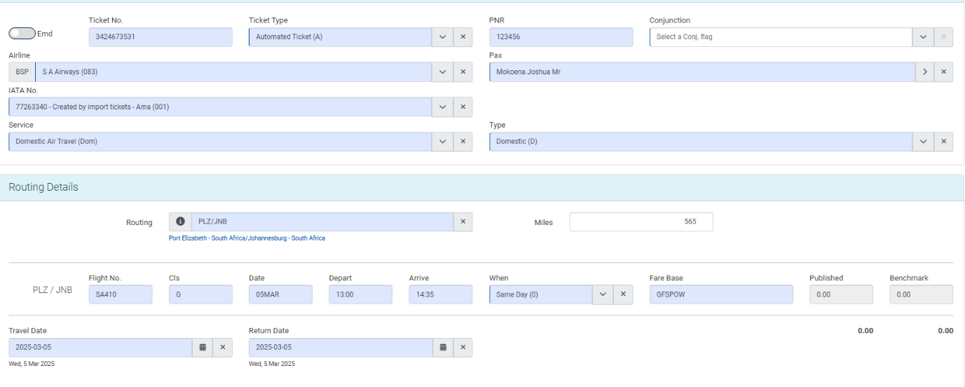
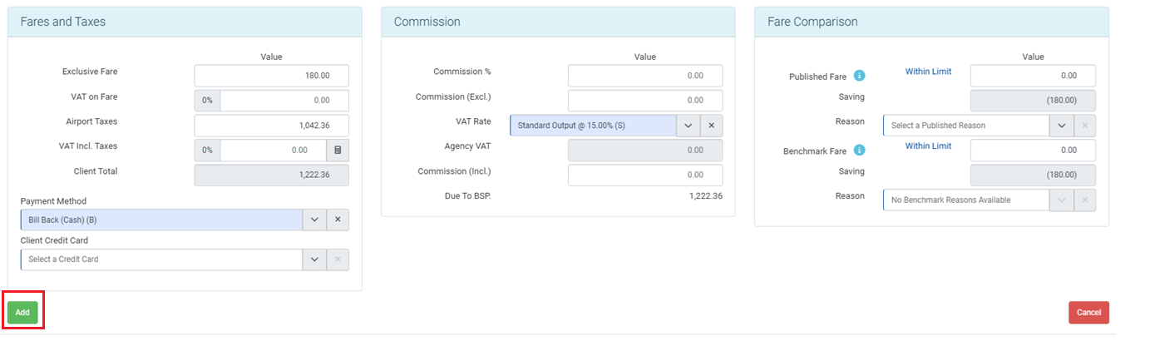
Complete all compulsory fields from example tickets:
How to calculate Airport Tax:
Total: R1 222.36
Less the Air Fare: R180.00
Less the ZV (VAT): R27.00
Total Airport Tax: R1 015.36
Once all fields completed as example – select “Add”

Slide 31
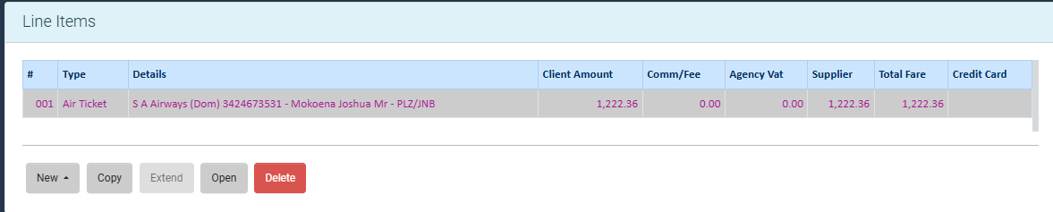
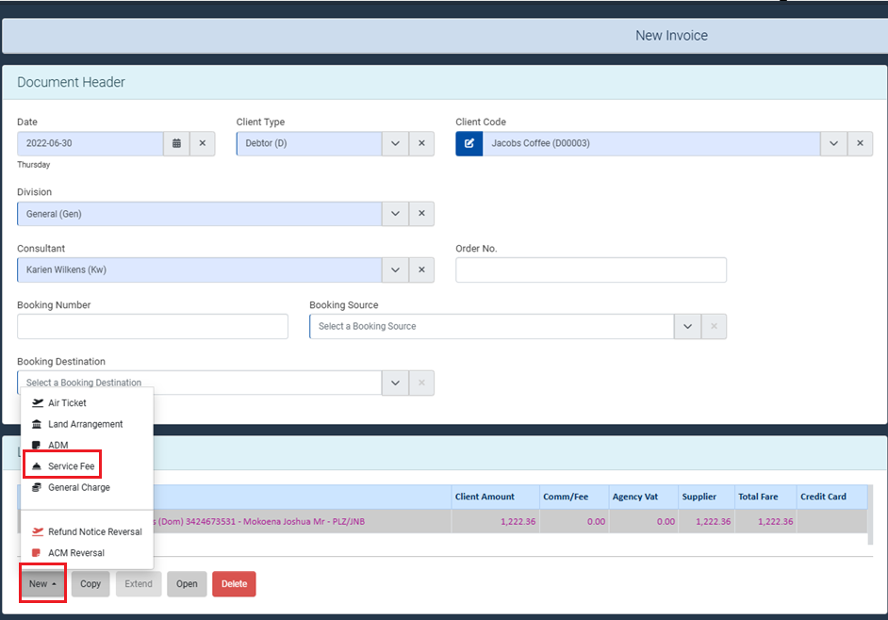
After adding the air ticket, your invoice will display as below with 1 line item:
Now all that is left to do is to add a service fee
** PLEASE NOTE ALL INVOICES WILL HAVE A SERVICE FEE**
To add the service fee – select “New” and select “Service Fee”

Slide 32
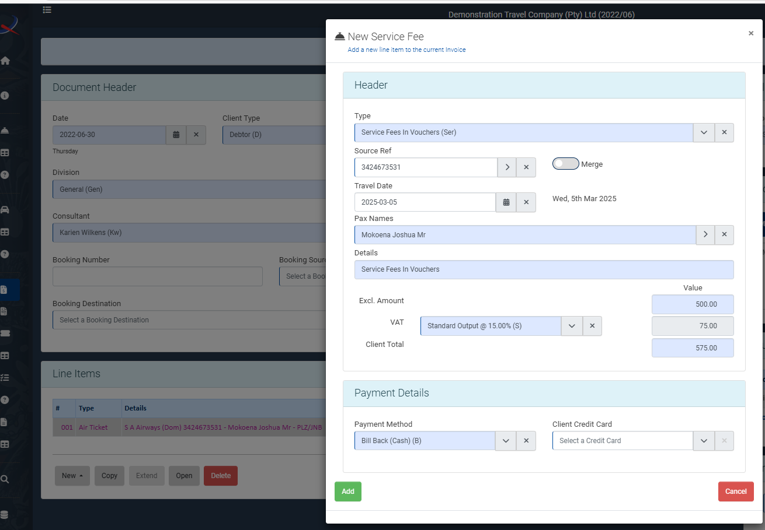
Type will be “Ser”.
In the “Source Ref” column, select the arrow pointing right and select the ticket number from the drop down. By doing this, your “Travel Date” and “Pax Names” will match with your air ticket details.
Ensure that when the service fee is excluding VAT you add the amount in the “Excl. Amount” field.
If the service fee in including VAT you add the amount in the “Client Total” field
Once all fields completed, “Add” the service fee to the invoice.
Your invoice should now display a total of 2 line items.

Slide 33
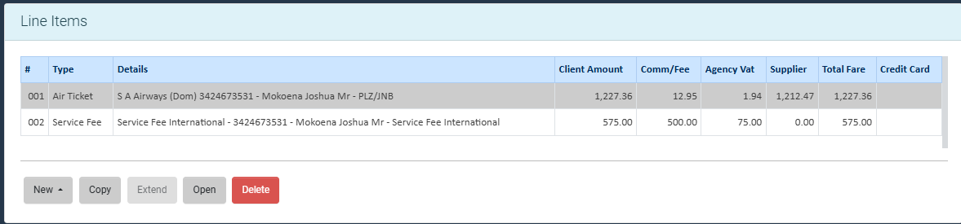
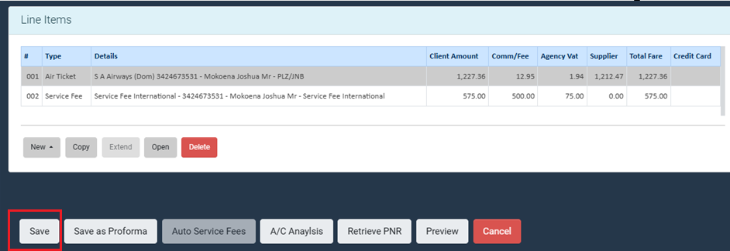
Once the air ticket and service fee are added to the invoice, move down to the end of the screen and save your invoice.

Slide 34
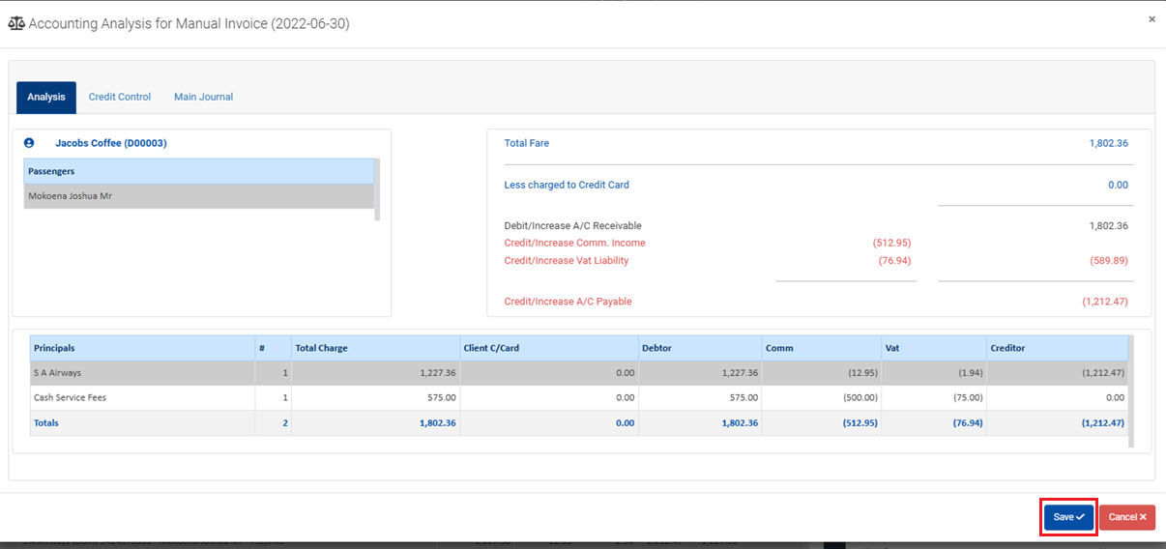
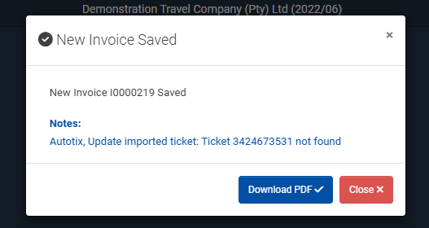
On the Accounting Analysis, just select “Save” again:
You should get the below response if invoice has been saved successfully:

Slide 35
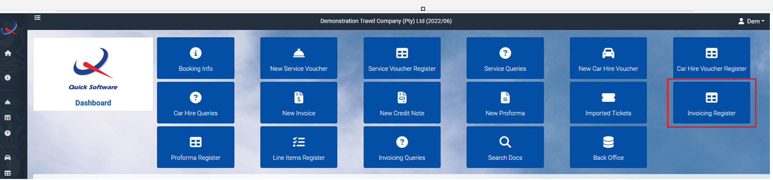
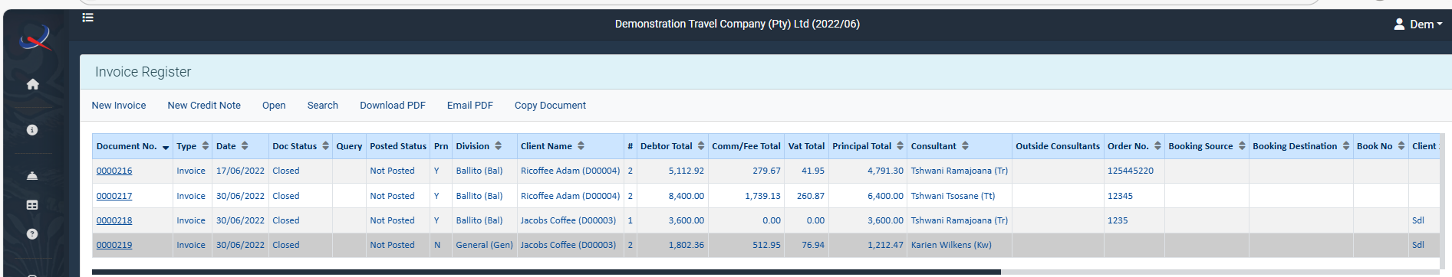
You can view the “Invoicing Register”
Invoice Register:

Slide 36
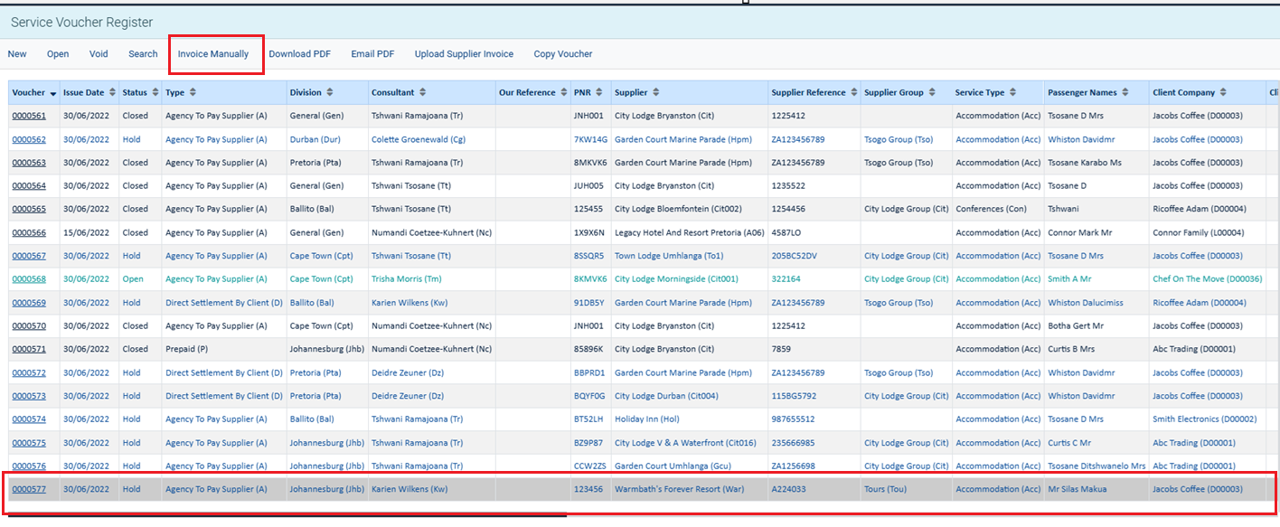
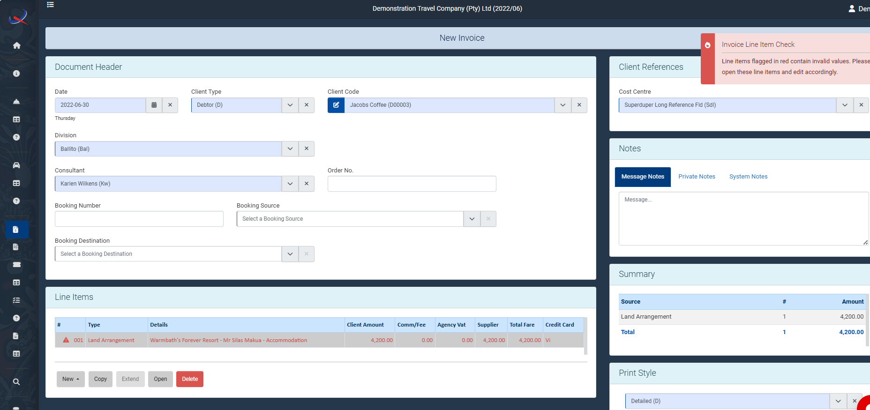
Now all that is left is to invoice your accommodation voucher & car voucher.
How to invoice an Accommodation Voucher:
Locate the voucher in the “Voucher Register” and highlight the selected voucher and select “Invoice Manually” at the top.
By selecting “Invoice Manually” a new invoice will open with your accommodation voucher as line 001.

Slide 37
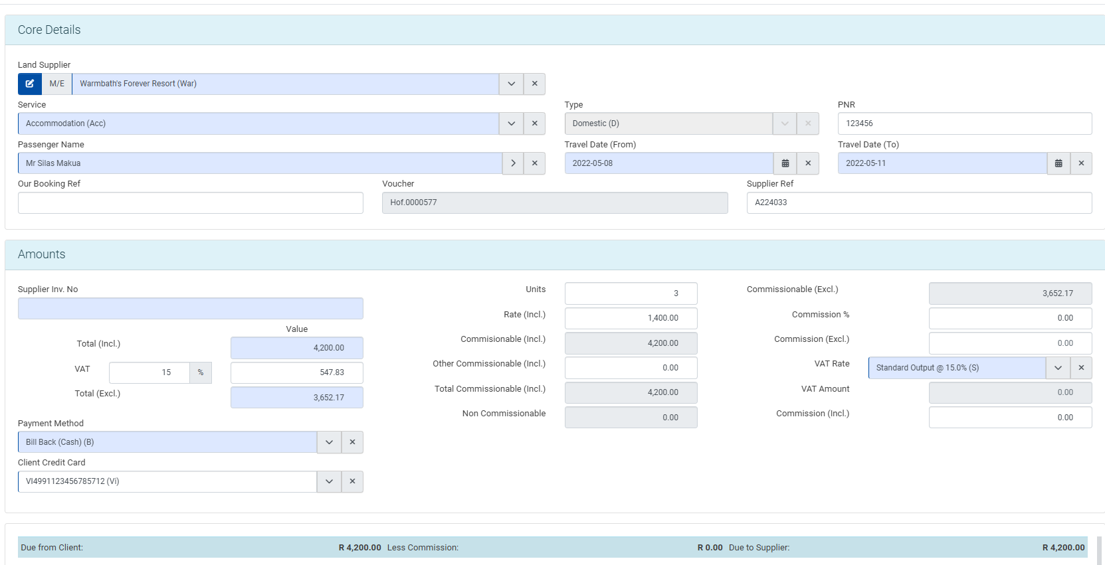

The line item will display in “Red” – please open the voucher line and add in the “Supplier Inv No”.
Once all fields have been completed, select “Update”
** Remember to add in your service fee and save your invoice **

Slide 38
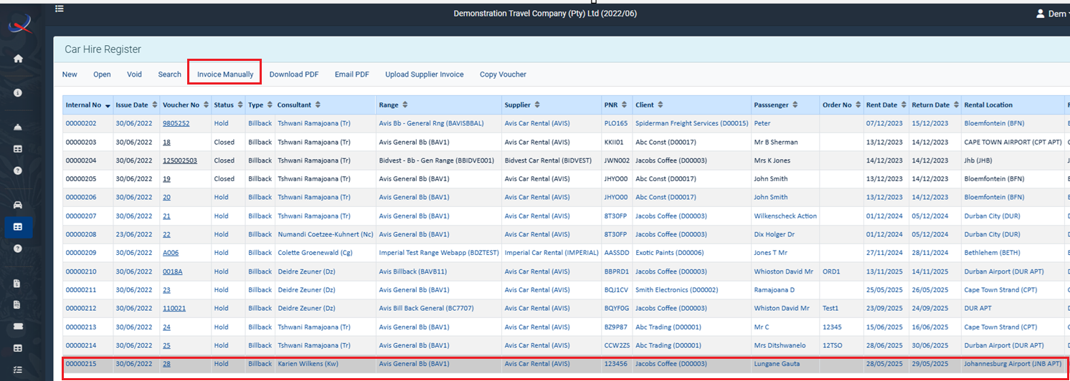
How to invoice car voucher:
Locate the car voucher from the “Car Hire Voucher Register”, highlight the voucher and select “Invoice Manually”.
By selecting “Invoice Manually” the car voucher will be on a new invoice now – again in red, please then open the invoice, line item 001 to add “Supplier Inv No” but also the values as this was not done on your car voucher:

Slide 39
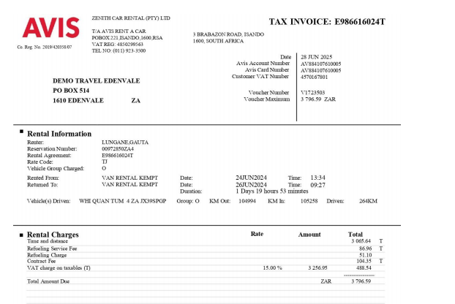
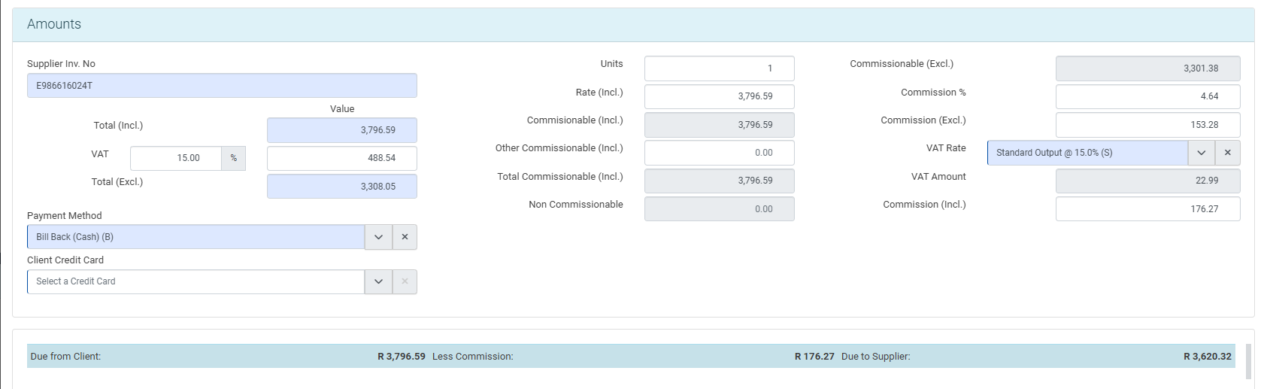
Keep in mind that fuel is not vatable and you will need to amend your VAT amount manually to match the supplier invoice.

Slide 40
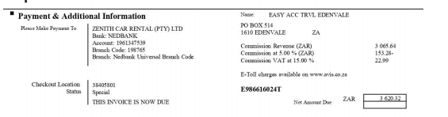
On this car voucher we are getting commission back and this needs to be captured on the invoice:
5% Commission + VAT on the commission = Commission Incl.
** Remember to add in your service fee and save your invoice **
Once all fields have been completed, select “Update”

Slide 41
If you have any questions, feel free to ask.
THANK YOU

